Slide 1

From Student Success to Lifelong Achievement
The Importance of Mental Health
March, 2015
PETHS School Council

Slide 2
Have we gotten it right?
Does student success
=
livelong achievement?

Slide 3
Our Task as Parents and Educators
To prepare our children/students to be:
Ready for the post secondary and employment world
Positive contributors to society
Healthy and Thriving

Slide 4
Who we are and how we engage in the world are much stronger predictors of how our children will do than what we know about parenting. The question isn’t are you parenting in the right way? It is Are you the adult you want your child to grow up to be?
Brene Brown

Slide 5
The Relationship to Mental Health
Wellbeing is not about absence of illness but about health and resiliency:
Self regulation
Self concept
Self acceptance
Connectedness/Belonging

Slide 6
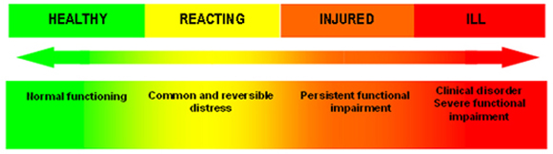
Holistic Approach

Slide 7
Dangers of Perfectionism
(Unbalanced Achievement Orientation)
Students demonstrating perfectionism are at high risk for mental health challenges
Anxiety
Depression
Suicidality in relation to perceived failure

Slide 8
Dangers of Perfectionism
Anxiety is a necessary feature to support a perfectionist frame of reference
Use of Substances to stay competitive (coffee…stimulants…cocaine…)

Slide 9
A Culture of Perfectionism?
Education phenomenon or Social phenomenon?
Research suggests perfectionism is on the rise in adolescents.
Flett and Hewitt (2014) concluded that 3 in 10 adolescents have some form of maladaptive perfectionism

Slide 10
Employers value…
Demonstrated Emotional Intelligence (EI)
Skills and Knowledge
Capacity for Creativity, Innovation (this requires risk taking!)
Collaborative Capacity (danger of the solo artist)

Slide 11
Misconception
Perfectionism is not a predictor of achievement
Fear of failure, procrastination, and anxiety can all debilitate

Slide 12
When should I worry?
High anxiety
Hesitancy to move outside of the comfort zone
Anxiety based procrastination
Hyper-competitiveness
“All or Nothing” Thinking
Dysregulated affect: high distress for perceived “failures”

Slide 13
How to determine if perfectionism is a problem
Is their performance drive or anxiety stopping them from doing things that they want to do?
Is it interfering with friendships, school work, or family life?
Is your child extremely distressed by feelings of failure, not being perfect?
Do you feel that a need to be perfect is determining too many of your child's decisions? How long have you felt this way?

Slide 14
A bit about the brain
Designed to keep our body in balance
Our body craves homeostasis
The brain supports adaptive functioning
It is hardwired to protect us

Slide 15
Why is this important?
Flight,
Fight,
or
Freeze

Slide 16
A Helpful Brain Model for Families
http://www.youtube.com/watch?v=DD-lfP1FBFk

Slide 17
Why is this important?
Long term impacts of chronic stress
Brain adapts to protect itself
Patterns of responding can be maladaptive

Slide 18
The Threat of Unbalanced Achievement Orientation
Relationship to identity
All or nothing thinking
Anxiety

Slide 19
Changing Our Response

Slide 20
If the day ever came when we were able to accept ourselves and our children exactly as we are and they are, then, I believe we would have come to an understanding of what "good parenting" means.
Fred Rogers

Slide 21
Understanding Our Needs
Foundations for Positive Mental Health

Slide 22
Neither comprehension or learning can take place in an atmosphere of anxiety.
Rose Kennedy
Notes:
CASSIDY

Slide 23
The Significance of Safe Space
To learn students need to feel safe. When students don’t feel safe, the fight or flight center of the brain, the amygdala, fires and incapacitates the hippocampus, the new-learning center of the brain. Students then become survivors vs. learners (Nussbaum, 2012).
Notes:
CASSIDY

Slide 24
Connectedness and Belonging
The energy that exists between people when they feel seen, heard, and valued;
when they can give and receive without judgement; and when they derive sustenance and strength from the relationship.
Brene Brown

Slide 25
Caring Relationships and
Belonging
Brain is hardwired for belonging and connection
Survival instinct
This is a pivotal mediator in identity development

Slide 26
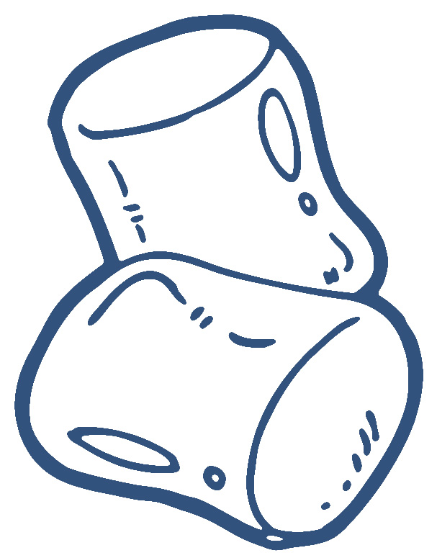
The Marshmallow Test
Revisited

Slide 27
What are our relationships with our children based on ?
Expectation with acceptance
Compassion
Embracing failure as learning

Slide 28
Self Regulation: Putting on the Brakes
We need our brain to have the alarm system, we wouldn’t want to turn if off BUT higher level cortical functions help us moderate it
Plasticity allows us to strengthen how the brain regulates
Notes:
CASSIDY

Slide 29
Responses to Stress:
Mind-Body-Behaviour Relationship
Mind (cognitive response):
negative thoughts, attitudes and feelings
Body (physiological response):
physical symptoms and bodily reactions
Behaviour (behavioural response):
things you do to cope

Slide 30
Understanding the Triad
MIND
Thoughts/Feelings
Behaviors
BRAIN/BODY
Physiology

Slide 31
Exercise
You are sitting in your room at night reading. You hear a noise/knocking at the window…..
Your first thought is…..

Slide 32
Exercise
What was your thought?
i.e. animal, branch, person/burglar
What did you say to yourself?
i.e. “ no big deal” (branch)
“oh no, I’ve got to get out of here” (burglar)
What feeling did your thoughts lead you to have?
i.e. fear/dread (burglar)
How would that feeling influence your behavior?
i.e. run/hide/shake/tremble

Slide 33
Man can alter his life by altering his thoughts.
William James
Notes:
Shilagh

Slide 34
Neurons that fire together…
Wire together
Where you focus attention stimulates certain parts of the brain
We are wiring our pathways
Let’s learn how to control it
CHOOSE to focus on the positive

Slide 35
Practice Letting Go
http://www.youtube.com/watch?v=rSrSemQUeSI

Slide 36
Mind, Body, and Behavior
Mindfulness
Paying attention to the present…
Without judgement
Without expectations
Without fear
Just accept it as it is….
Let’s practice

Slide 37
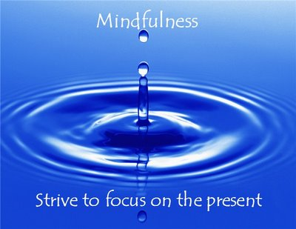

Slide 38

Strategies: Take up Smoking
Just kidding!
Why this works:
Taking a break physically from place/environment which generates stress
Deep breathing
3 breath hug
Let’s practice…

Slide 39
Self Compassion
Not about judging ourselves positively, but a way of relating to ourselves kindly, embracing ourselves lovingly flaws and all

Slide 40
Self Compassion
The thing that is really hard, ,and really amazing, is giving up on being perfect and beginning the work of becoming yourself.
Anna Quidlen
http://www.self-compassion.org/
Treating yourself as you would a good friend

Slide 41
Are you ready to change the lens?
http://www.ted.com/talks/shawn_achor_the_happy_secret_to_better_work?language=en

Slide 42
The 21 day Challenge
Daily:
Write down 3 new things you were grateful for that day
Journal one positive experience
Exercise
Meditation
One random act of kindness

Slide 43
Questions?

